Slide 1



Elements Profiles
elements.lshtm.ac.uk

Slide 2
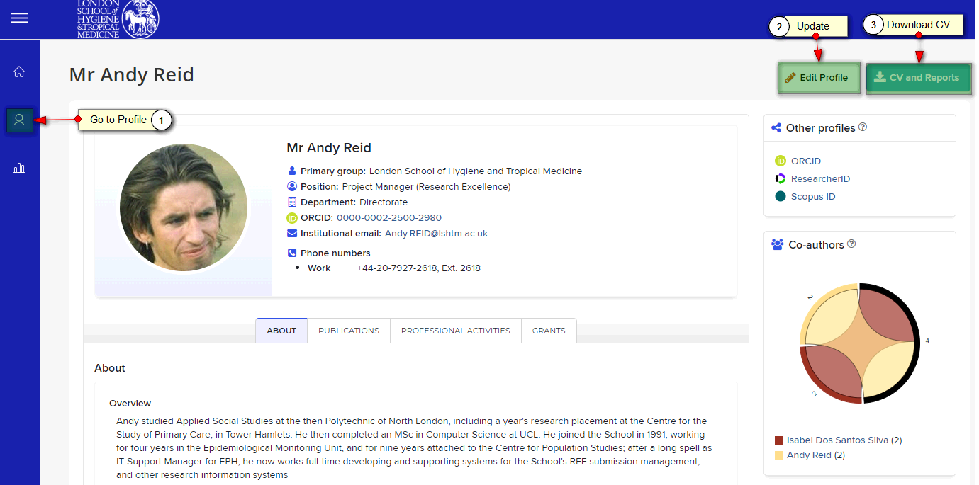
Elements Profile
Your Elements Profile contains some of the details that make up the CV template and web profiles:
Education, Experience, Degrees, Certifications and Post-Graduate Training. It is only visible to other logged in Elements users
Elements also feeds Publications, Professional Activities and Grants into the CV and profiles

Slide 3
Elements
Elements is the School’s Research Information System. It allows you to produce CVs tailored to School review and promotions procedures. It also provides the data for your online public profiles
To produce an up-to-date CV, you need to:
Add/update employment and education details
Add or Claim missing publications
Add yourself to Grants where you are a named Co-Investigator
Add/update professional activities such as Honours, Prizes, Learned Society, Journal and Funding Body roles
Generate the CV, check the automated output of the above, make any corrections in Elements
Generate final CV draft
fill in the manual sections

Slide 4
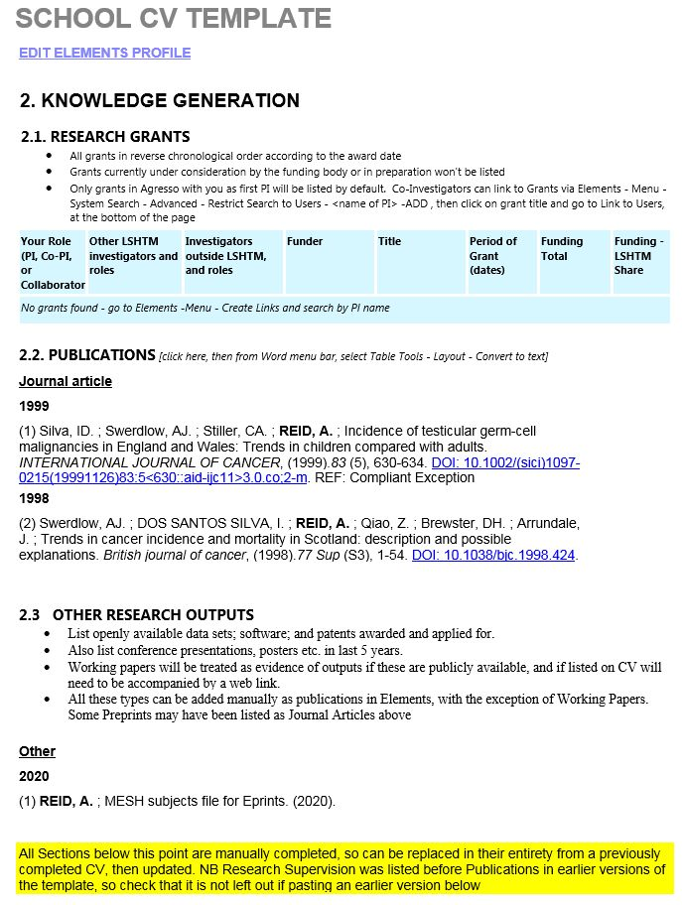
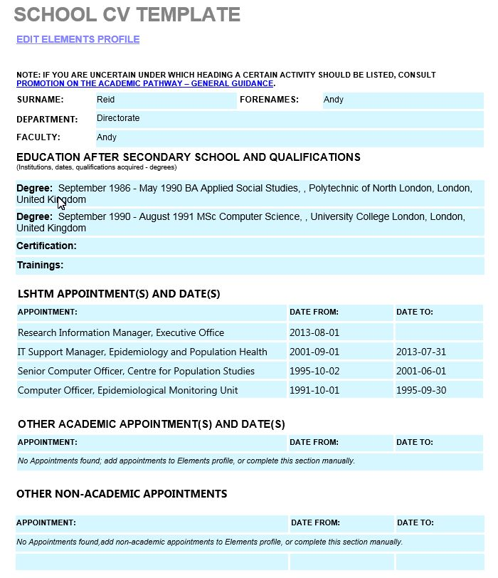
Elements CV Template
Elements will generate a Word document conforming to the School CV template, and pre-loaded with data from Elements, plus blank sections to be completed manually

Slide 5
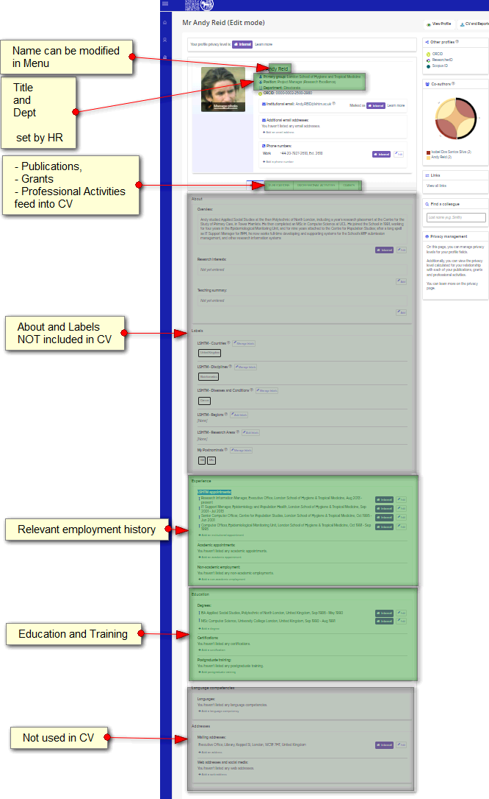
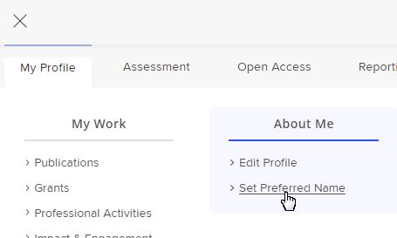


Edit Profile for CV
Your Profile contains some of the details that make up the CV template:
Name can be modified via Menu – About Me - Set Preferred Name
Title and Dept are drawn from HR/Registry records – contact them for corrections
Education, Experience, Degrees, Certifications and Post-Graduate Training
Enter in Elements – Edit Profile
Elements also feeds Publications, Professional Activities and Grants into the CV (See Menu – My Profile – My Work for details)

Slide 6
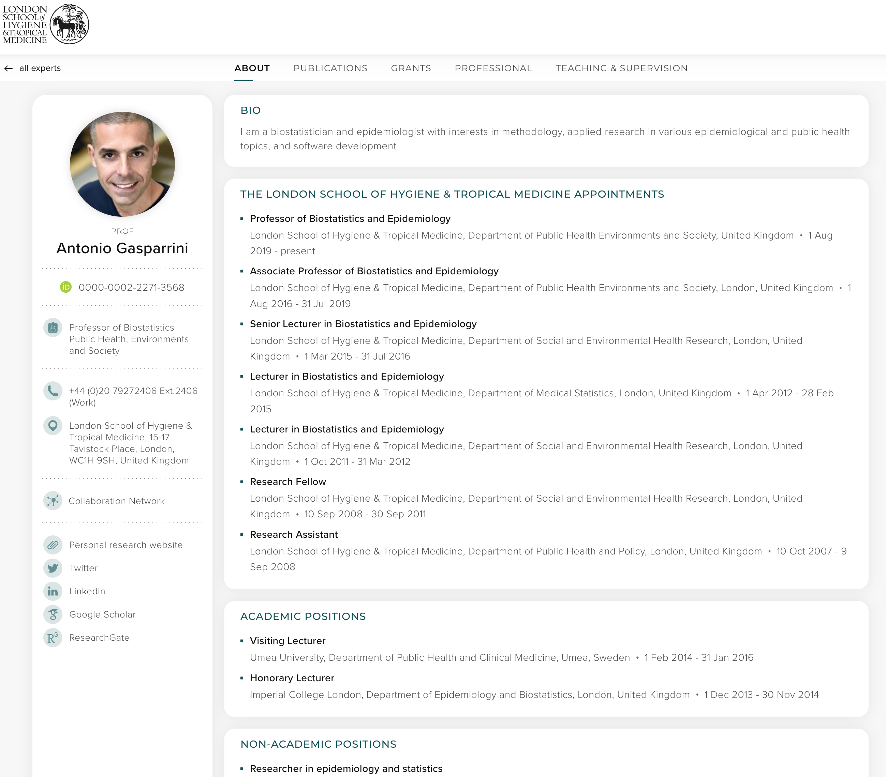
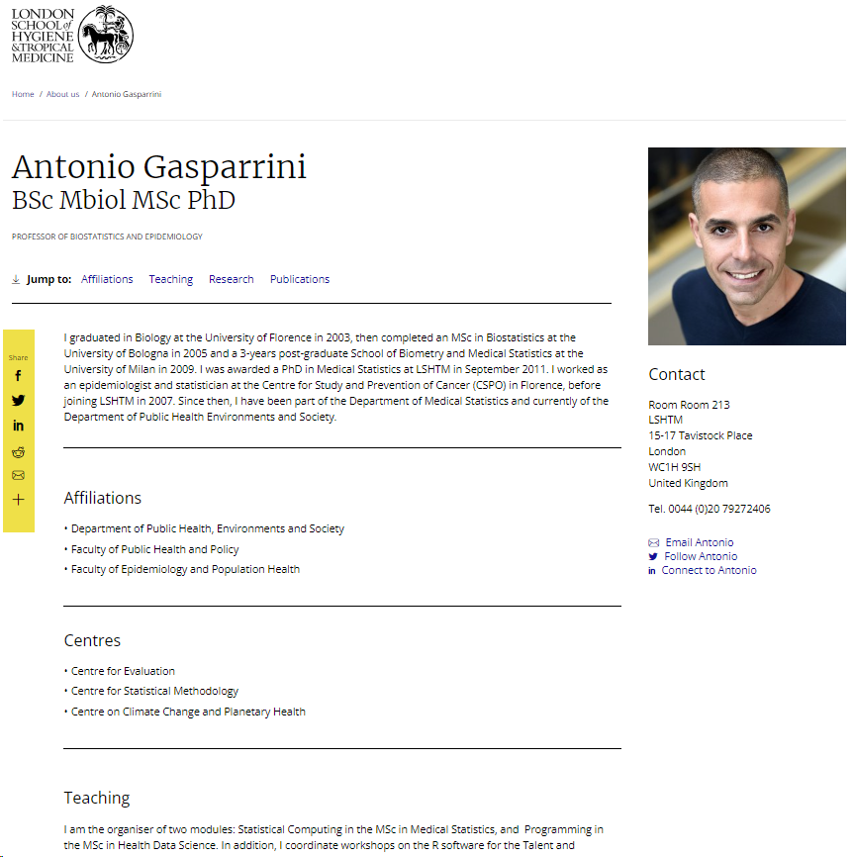
Discovery Profile
Gateway Profile

Slide 7
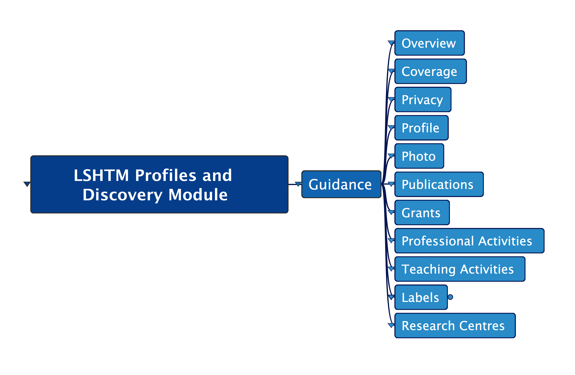

Slide 8
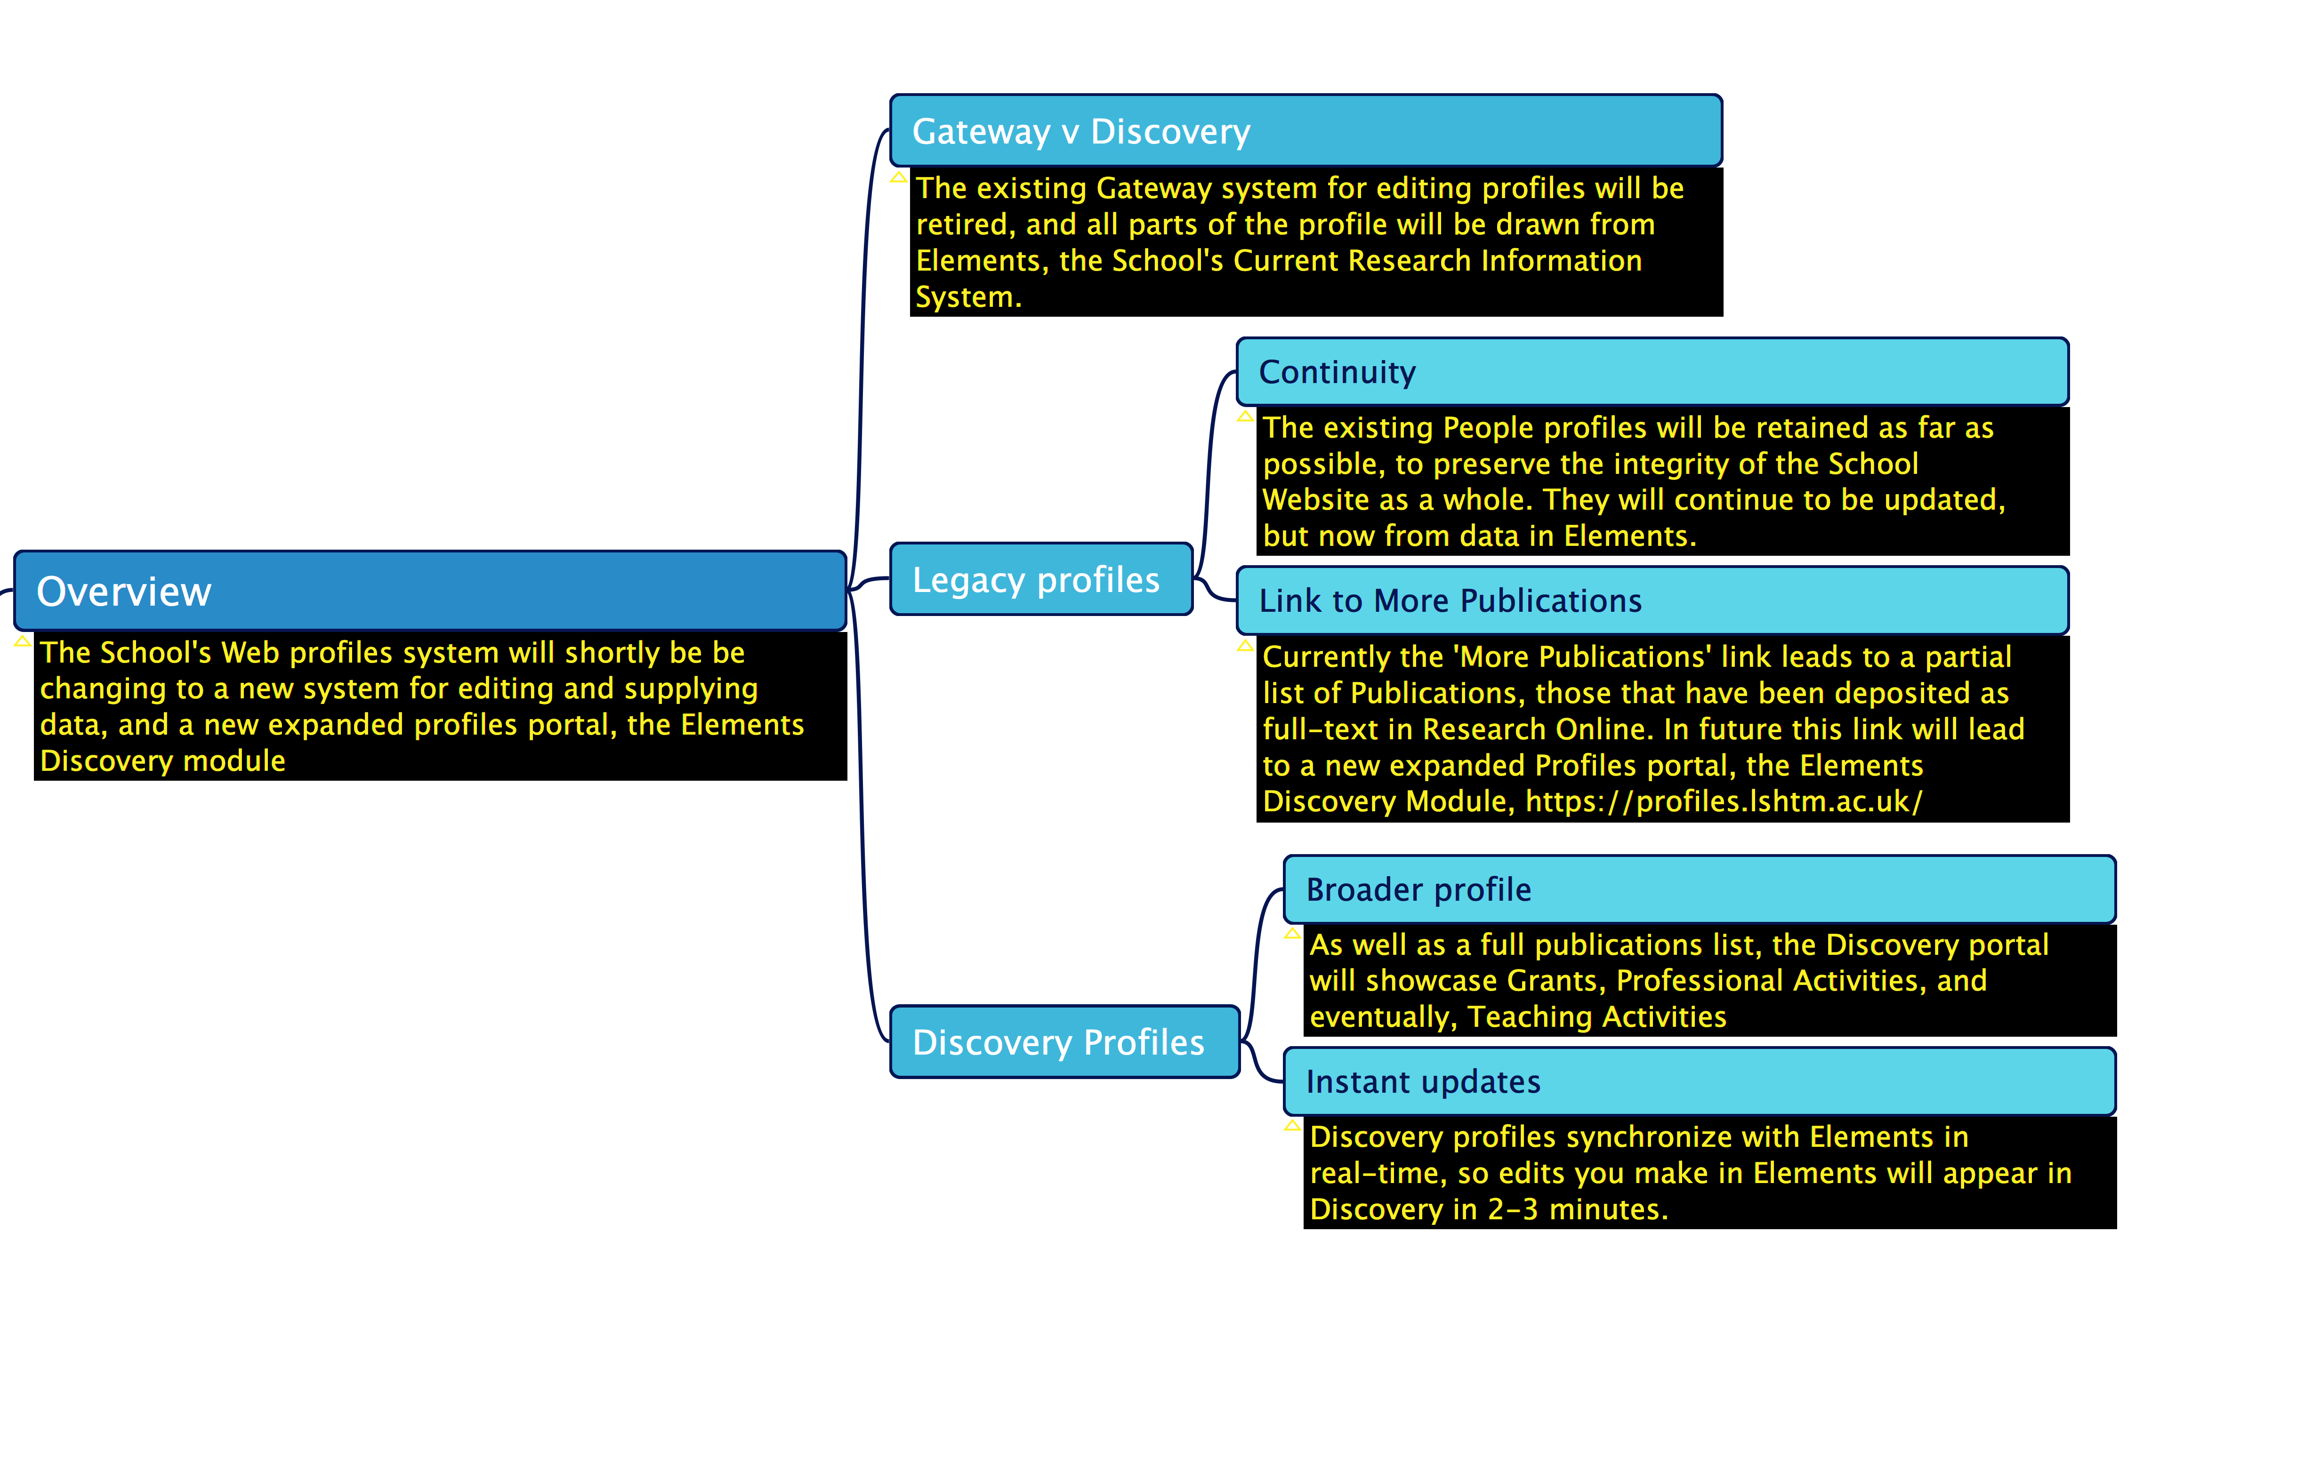

Slide 9
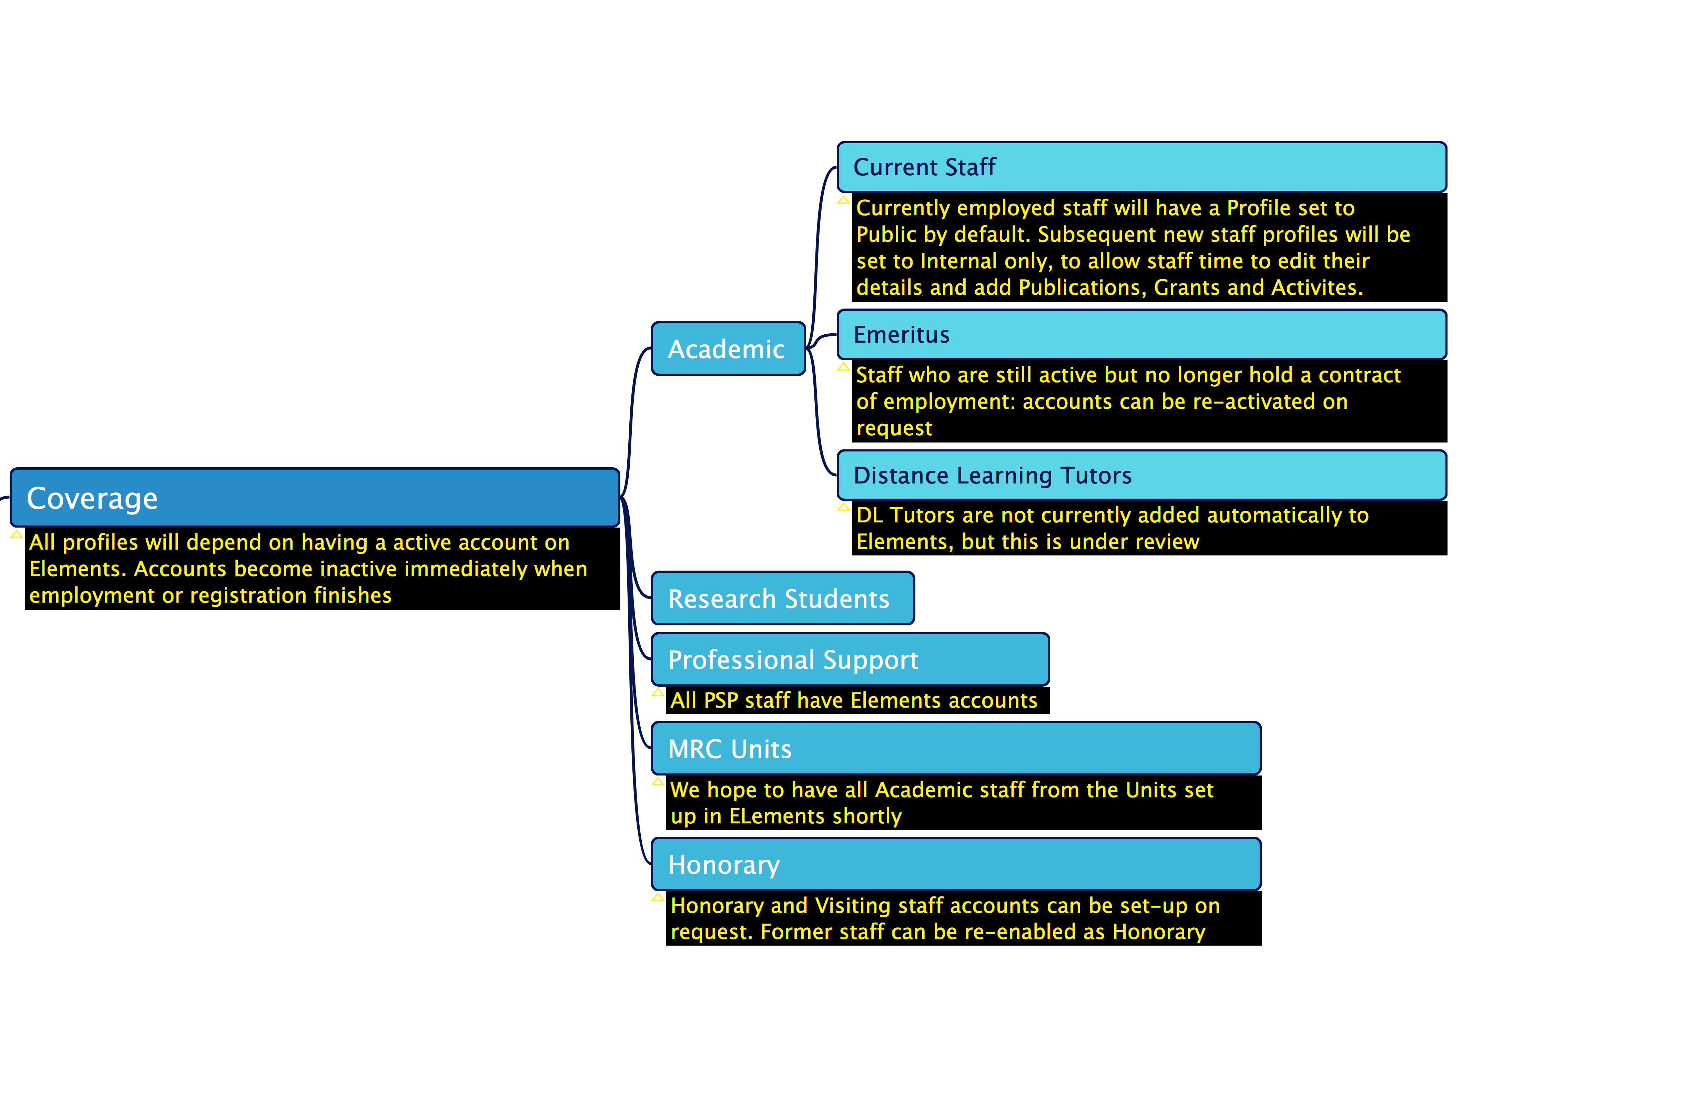

Slide 10
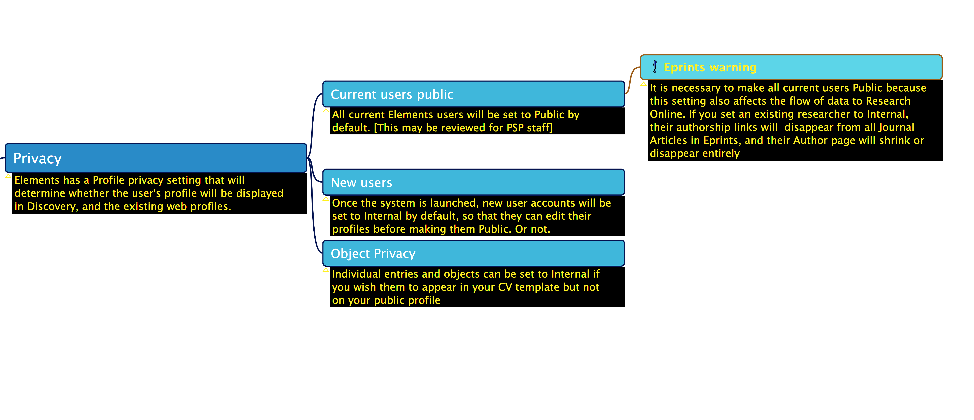

Slide 11
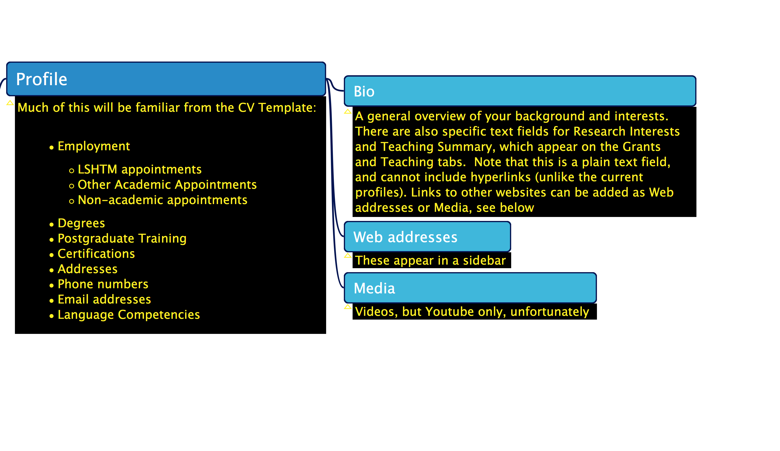

Slide 12
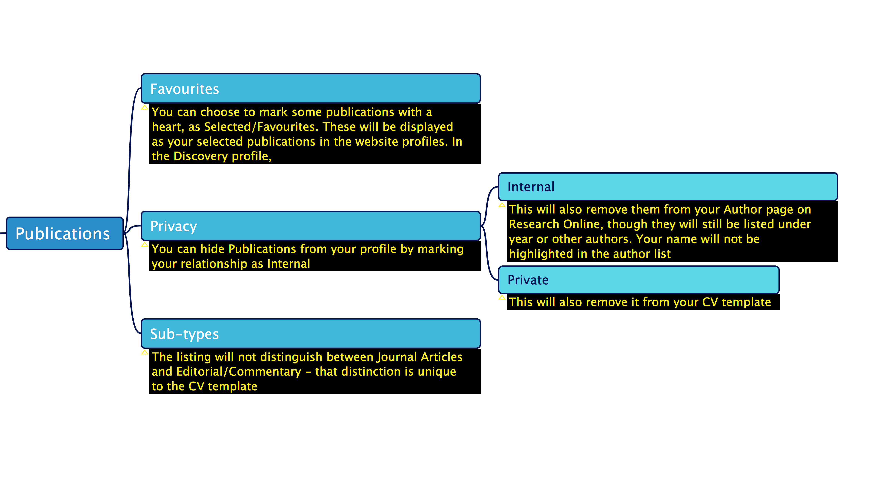

Slide 13
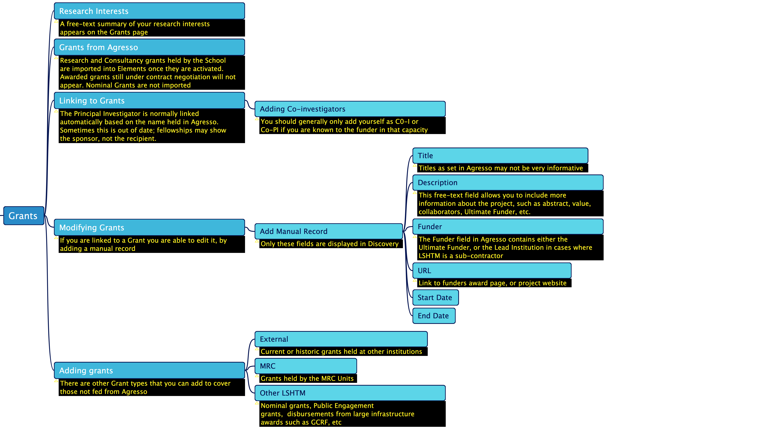

Slide 14
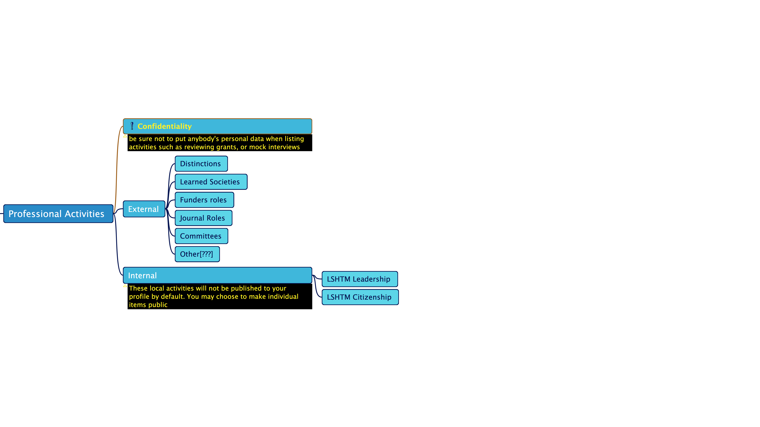
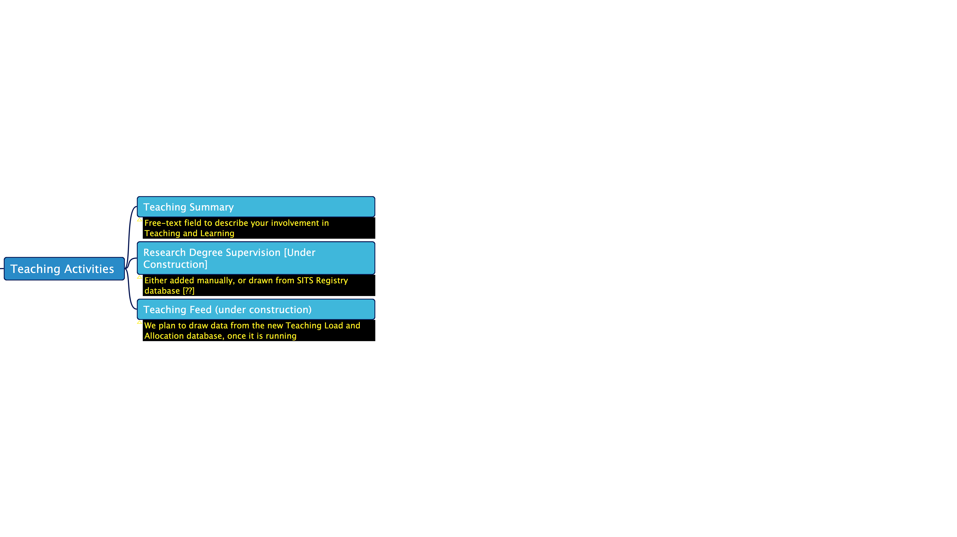

Slide 15
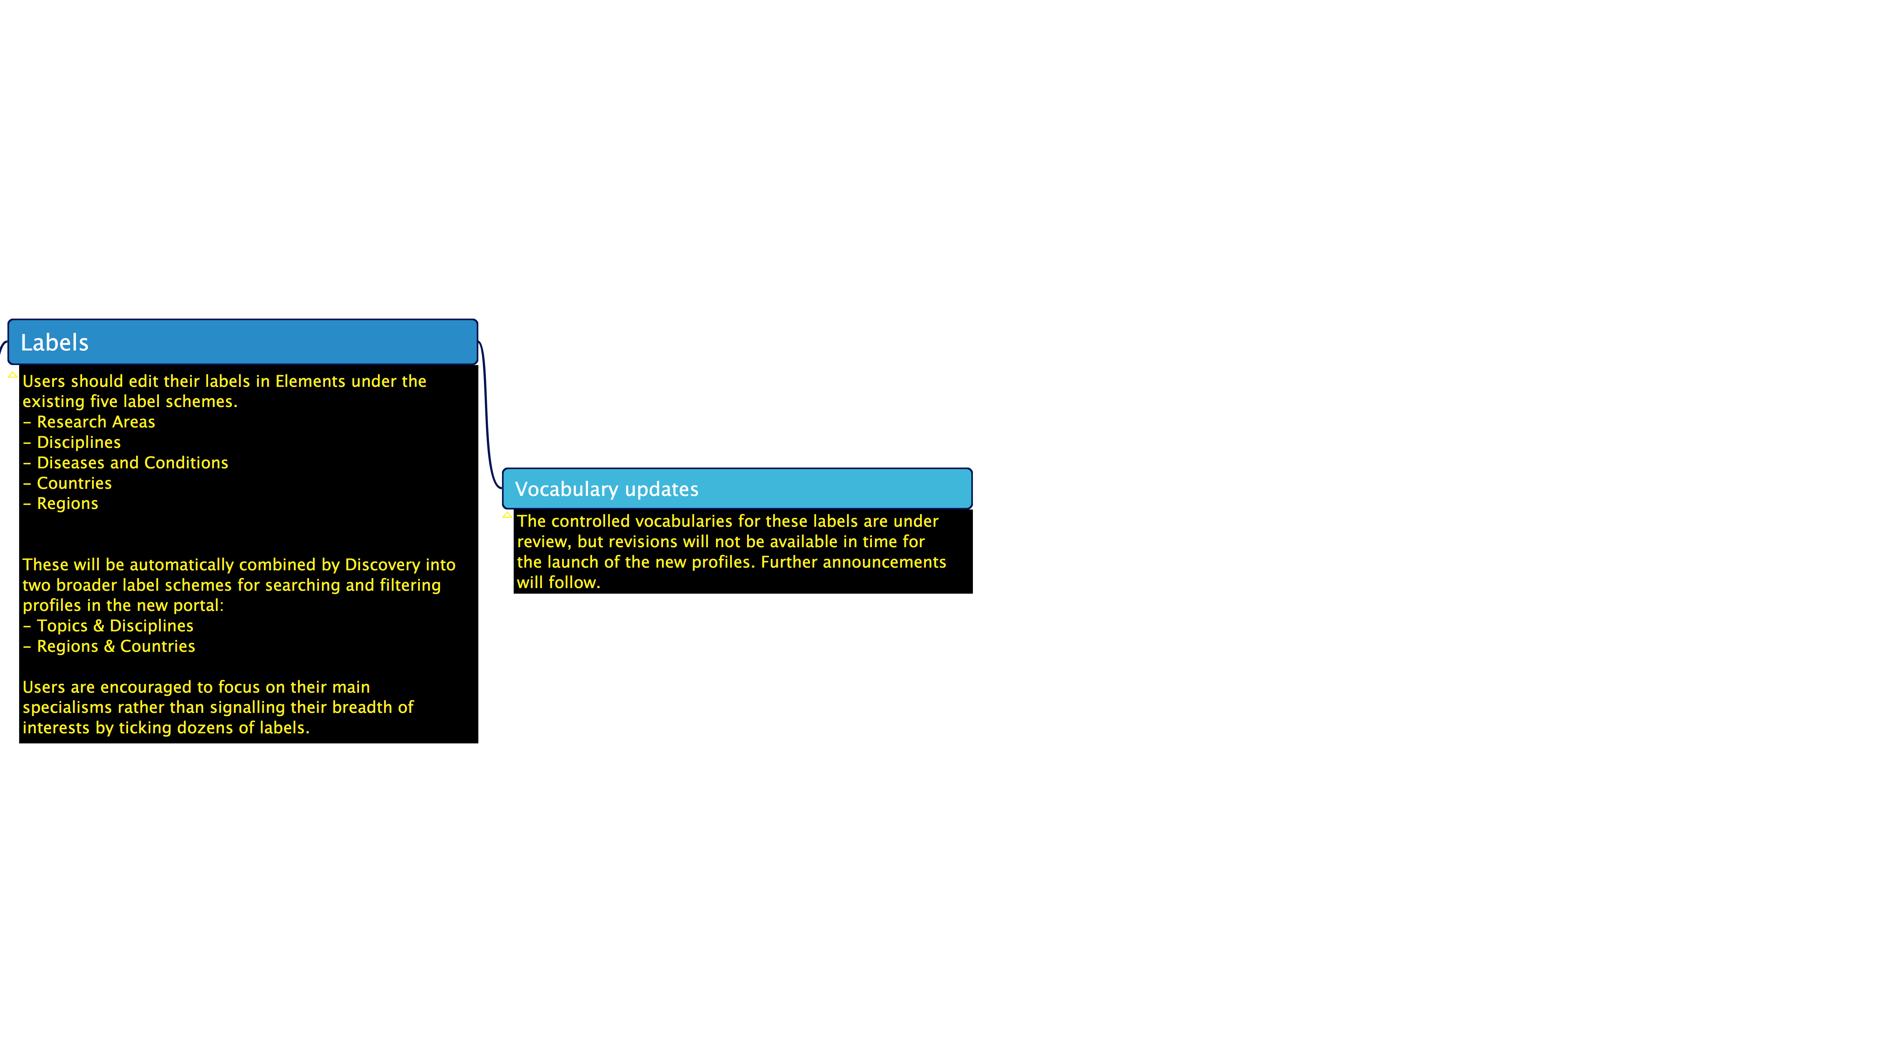
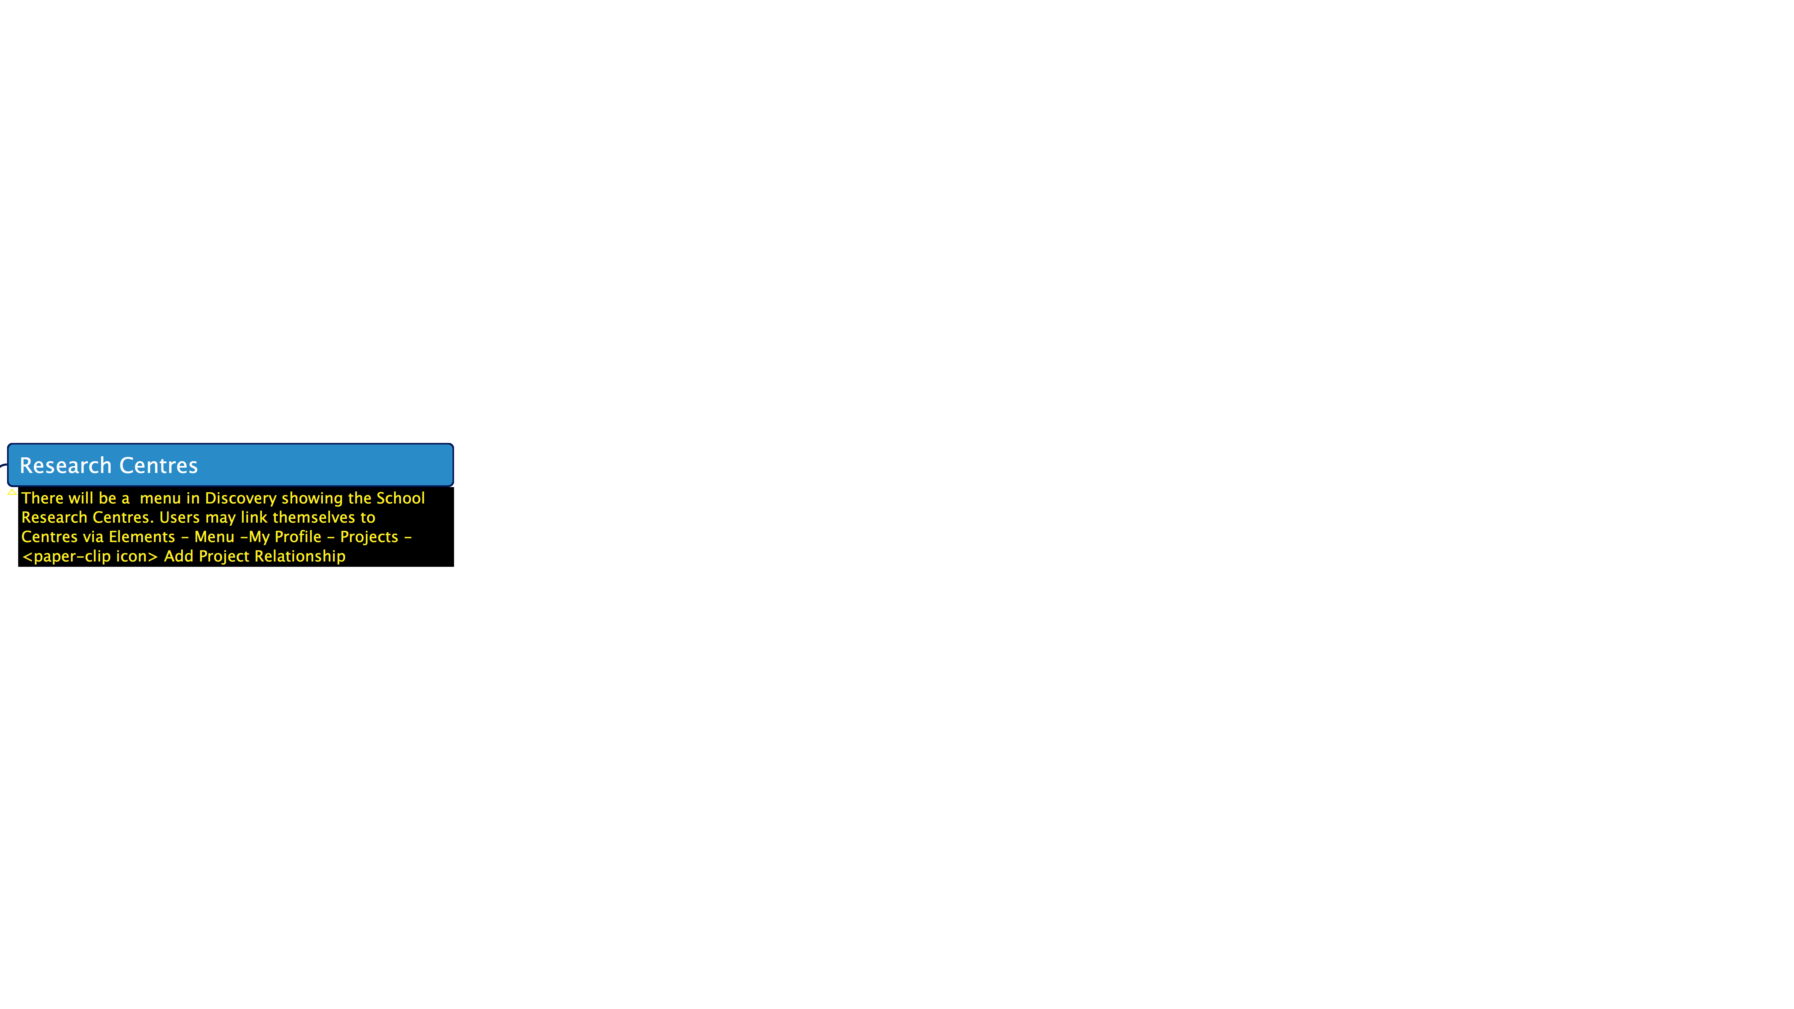

Slide 16
Help
Further material is available via the Help Page.
Further help can be sought via ServiceDesk .
Library, Archive & Open Research Services
Elements(CRIS)

